Slide 1
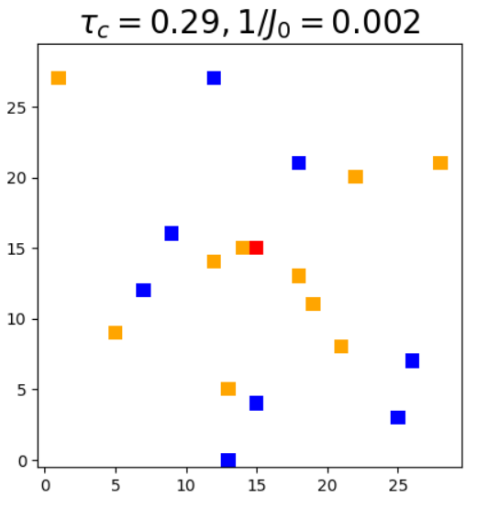
Single Spatial Configuration averaged over many measurements
All plots have arbitrary units
2 dim. Model with occupation probability 0.02 (30x30 lattice → expect 18 P1s in the bath)
Simulated echo and Ramsey to a total time of 1
On this timescale, tau_c of the bath is ~0.3 and the nearest neighbor coupling strength is 1/J₀ ~ 0.002
From Bryce’s email, took “early time” to mean 1/J₀ << t << tau_c, so I picked an early time t=0.05
“Late time” t=0.6
Only simulated stochastic flip-flops with coupling strength = J₀/r³; no T1 processes

Slide 2
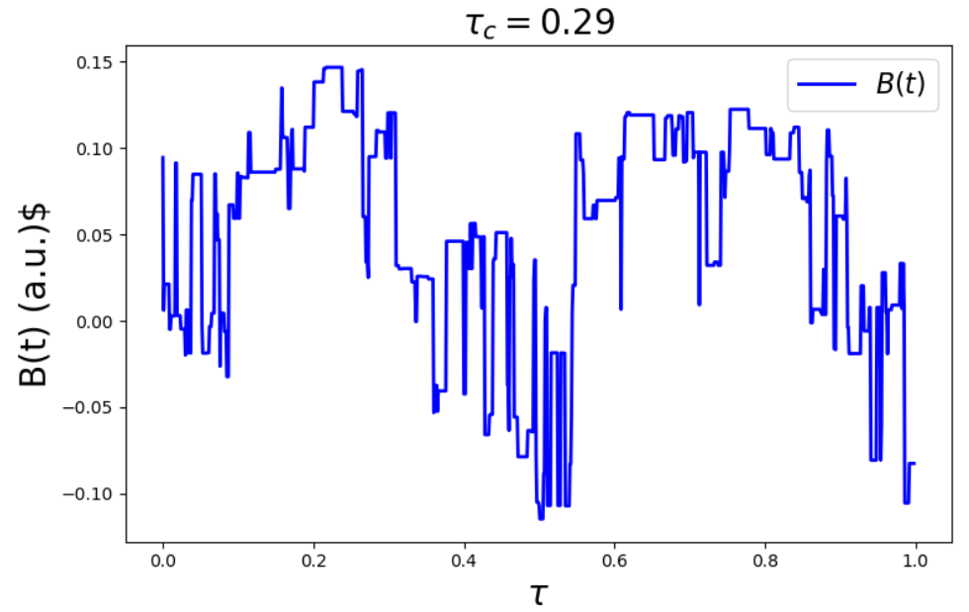
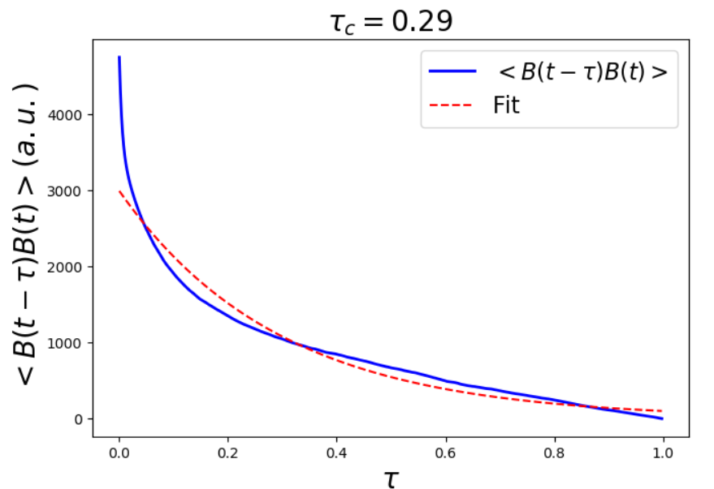
Correlation function <B(t+tau)B(t)> averaged over all measurements (axes accidentally incorrectly labelled as B(t-tau) instead of the correct B(t+tau))
Sample B(t) for a given experiment

Slide 3
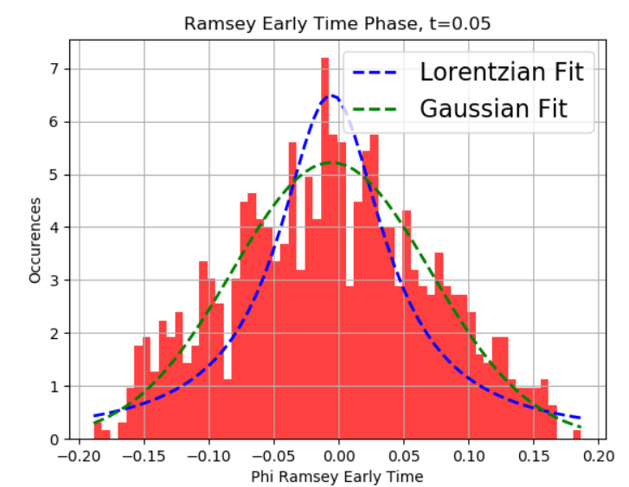
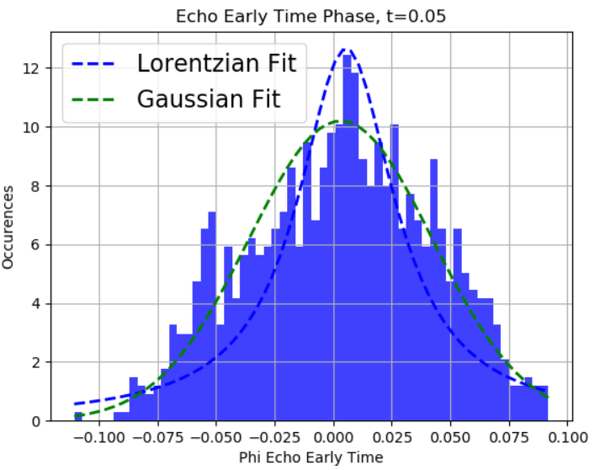
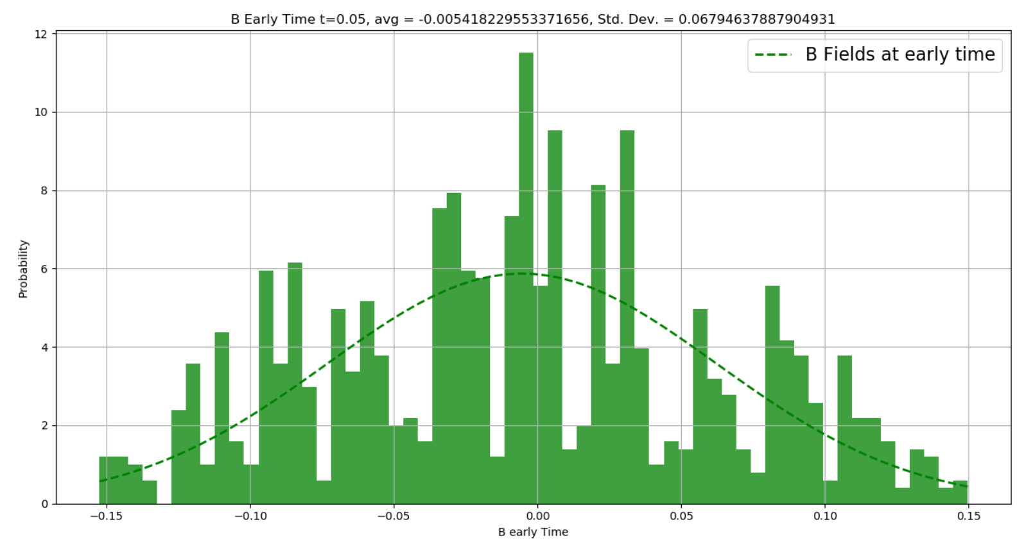
Early Time Phase, Ramsey and Echo
Y-axes should be “probability density” for the Lorentzian and Gaussians. Histograms are scaled to the normalized pdfs.

Slide 4
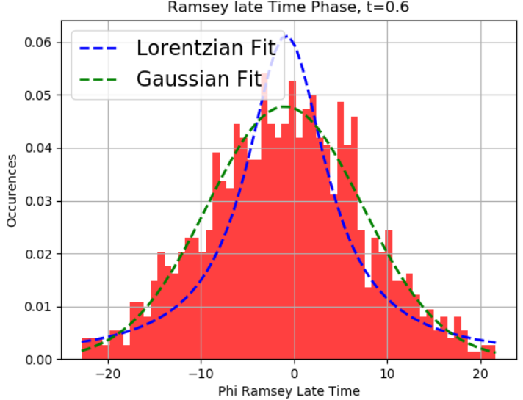
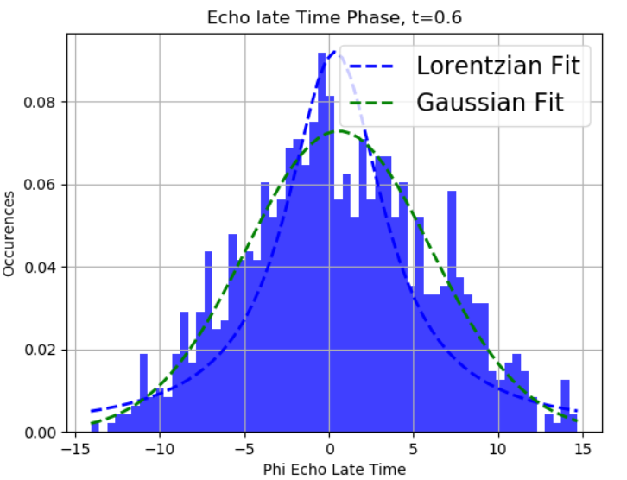
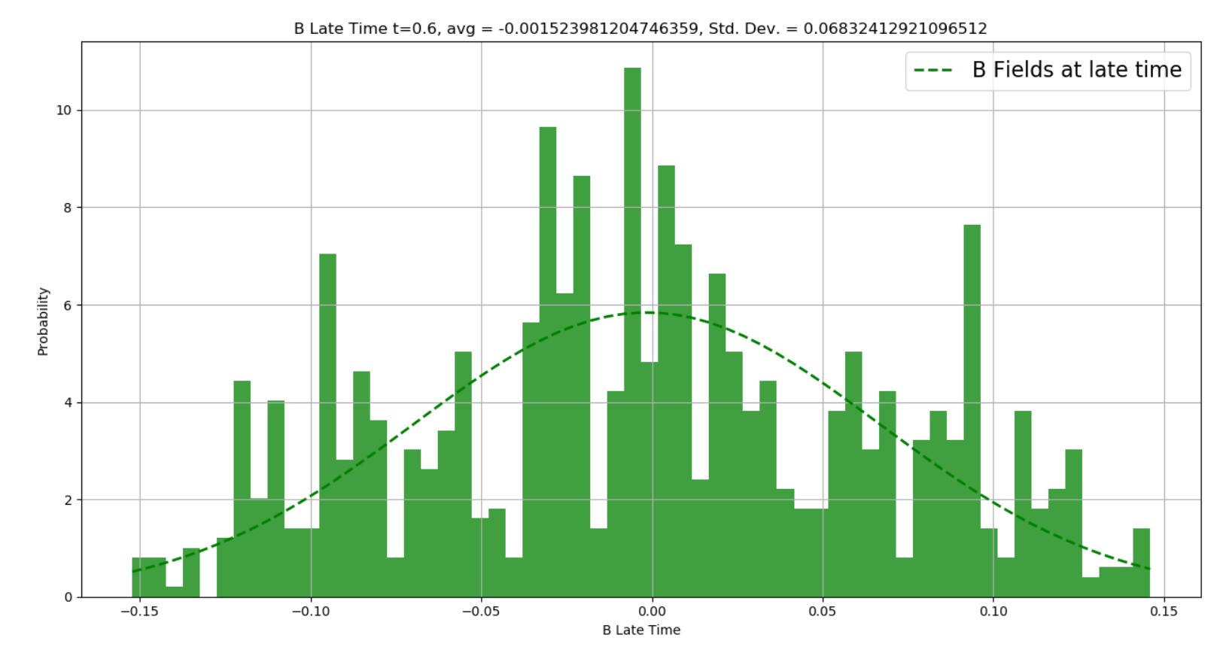
Early Time Phase, Ramsey and Echo

Slide 5
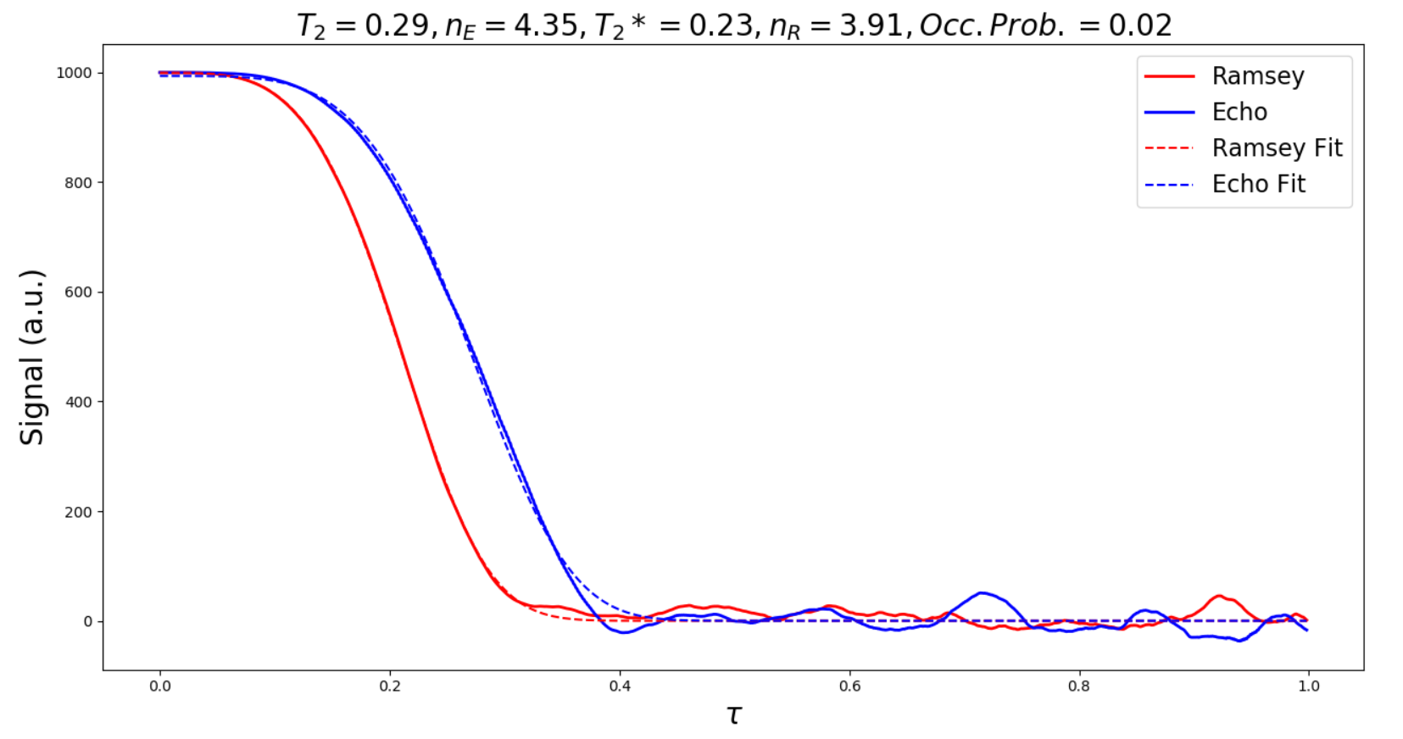
Decay calculated from taking <cos(phi)>

Slide 6
The next two sets of data are for an ensemble average

Slide 7
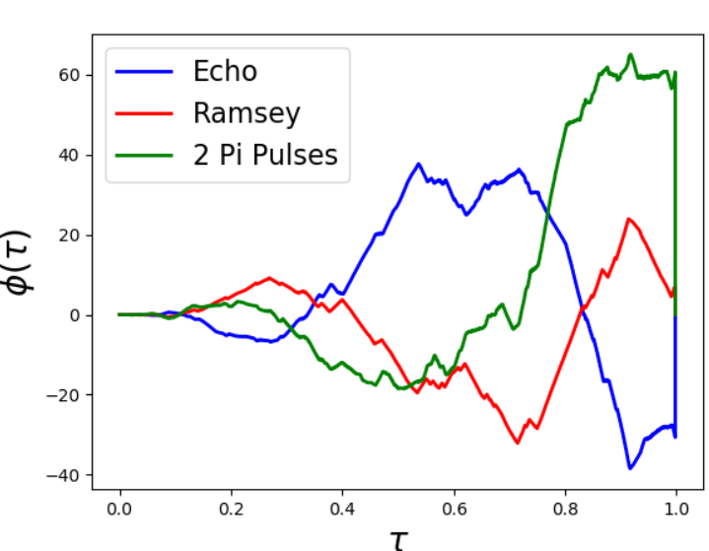
Distribution of phases at early and late times: Occ. Prob. 0.05
For a given spatial and configurational average, simulated the phase as a function of time. Then sampled the early time phase (A) and late time phase (B) at each run, and produced a histogram to get a sense for the probability distribution of phi at early and late times.
A
B

Slide 8
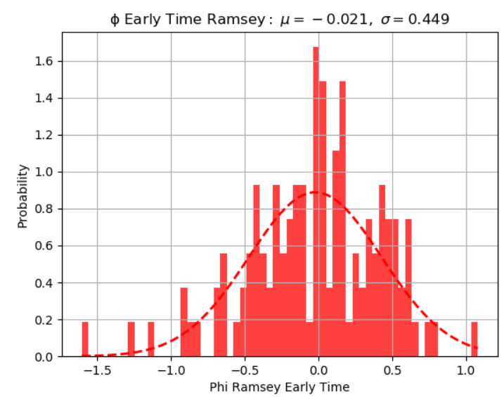
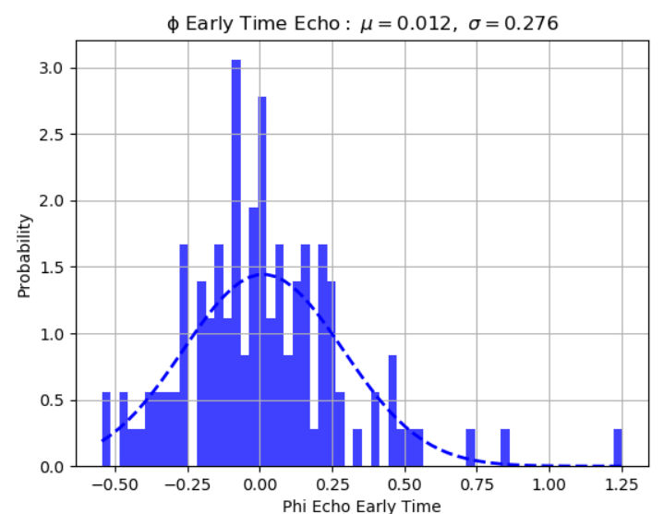
Early Time
Probability Density
Probability Density
Probability density is for the fit to the gaussian. The histogram is proportional to the number of occurrences for a particular phi.

Slide 9
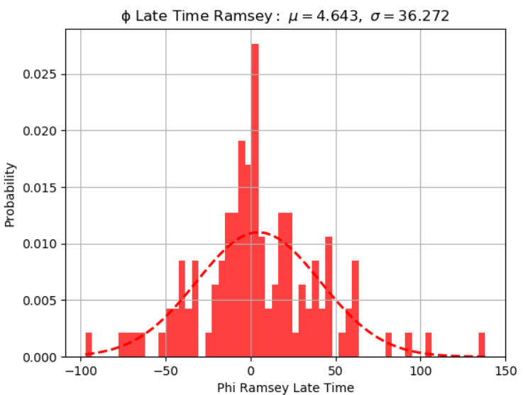
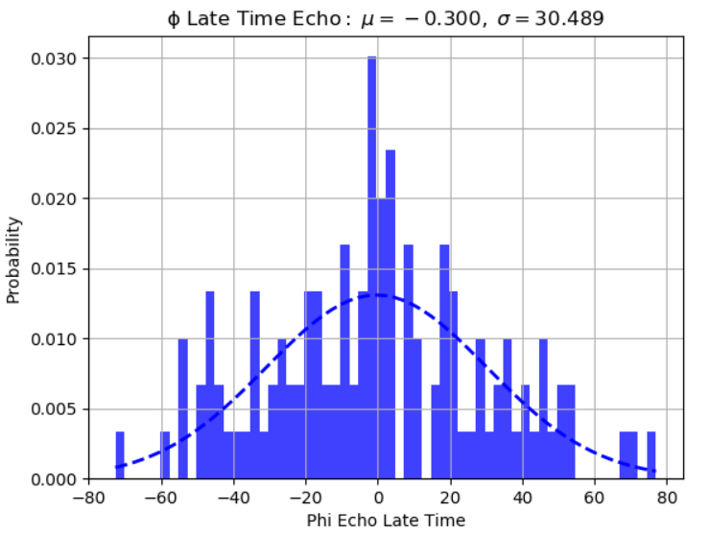
Late Time

Slide 10
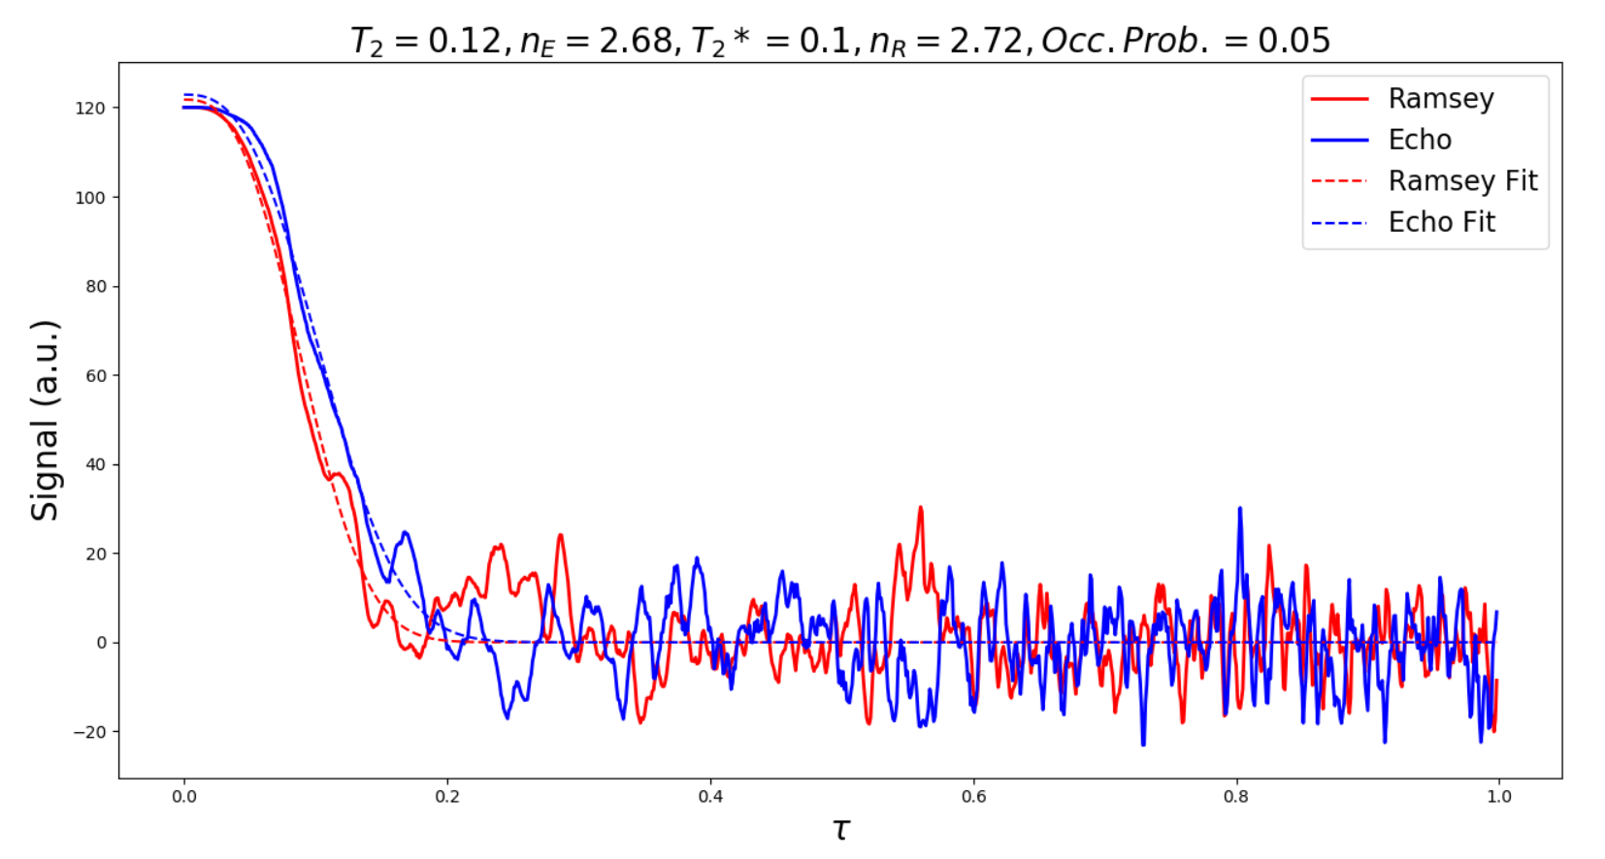
Resulting signal from the data on previous slides

Slide 11
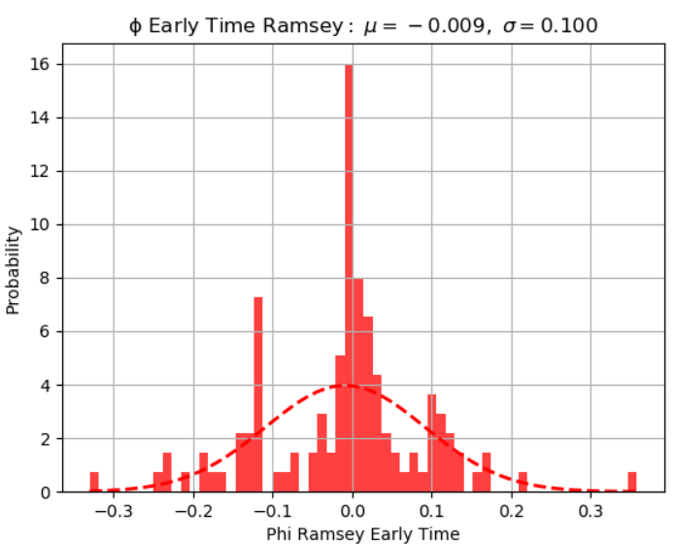
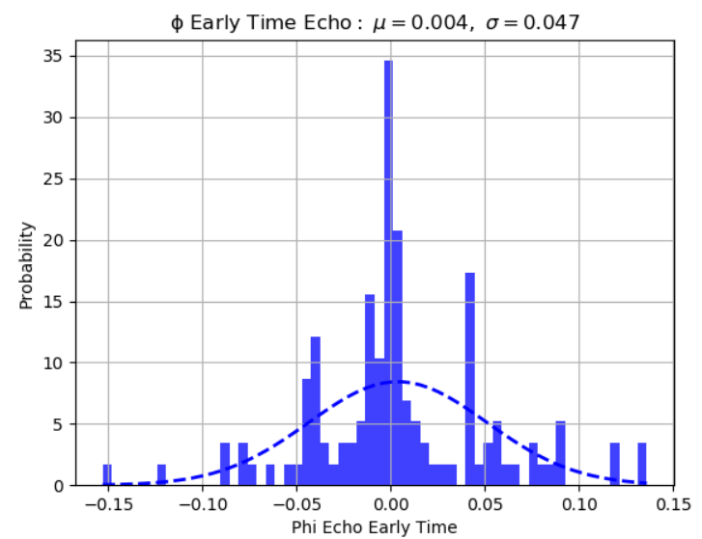
Occupation Probability 0.02; Early Time

Slide 12
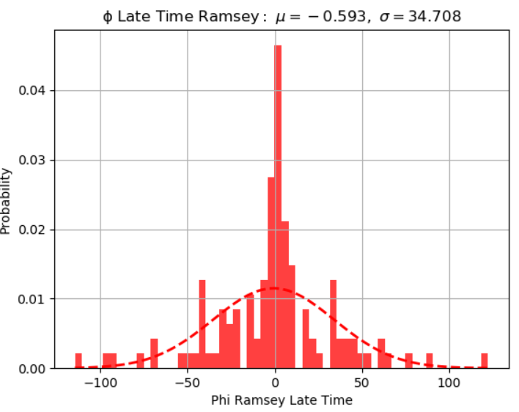
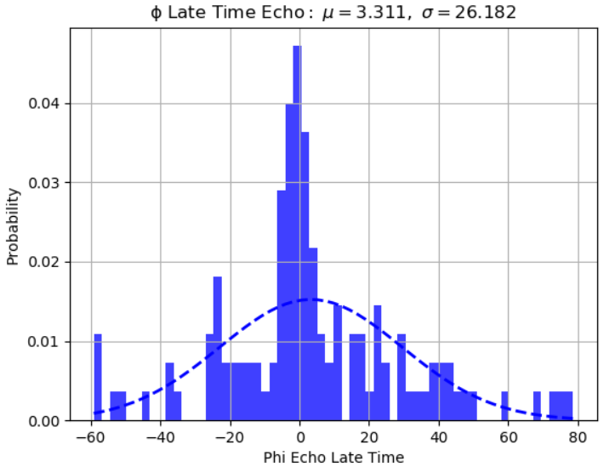
Late Time

Slide 13
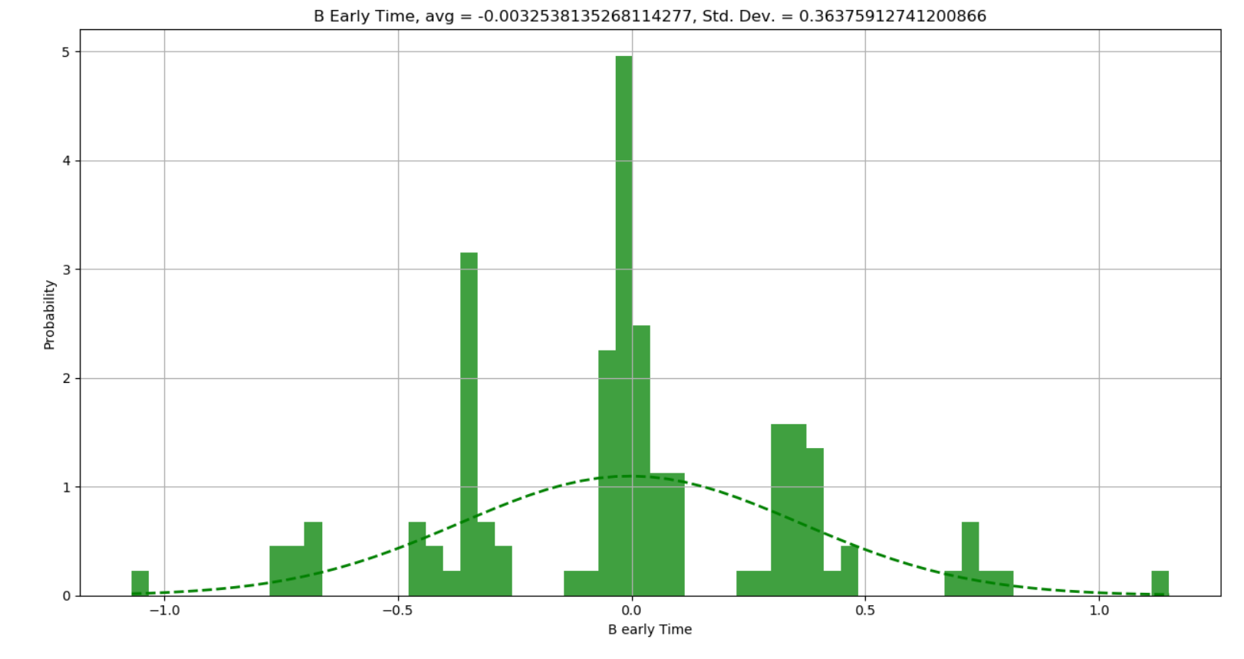
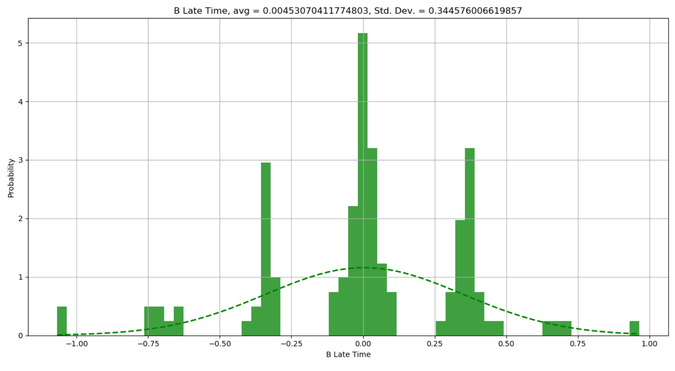
B fields

Slide 14
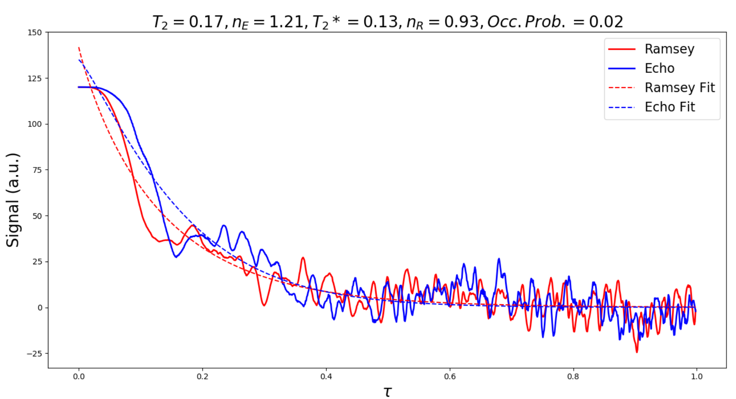
Decay calculated as <cos(phi)> (Ensemble averaged)

Slide 15
Updates to simulations:
Extended from single NVs to ensemble (2D)
For a given occupation probability, obtained B(t) from the bath dynamics
From B(t), obtained φ(t) and hence cosφ(t) for both Echo and Ramsey
Ran the above procedure 100 times to obtain <cos(φ)> for a given occupation probability
May need to average for much longer based on these results

Slide 16
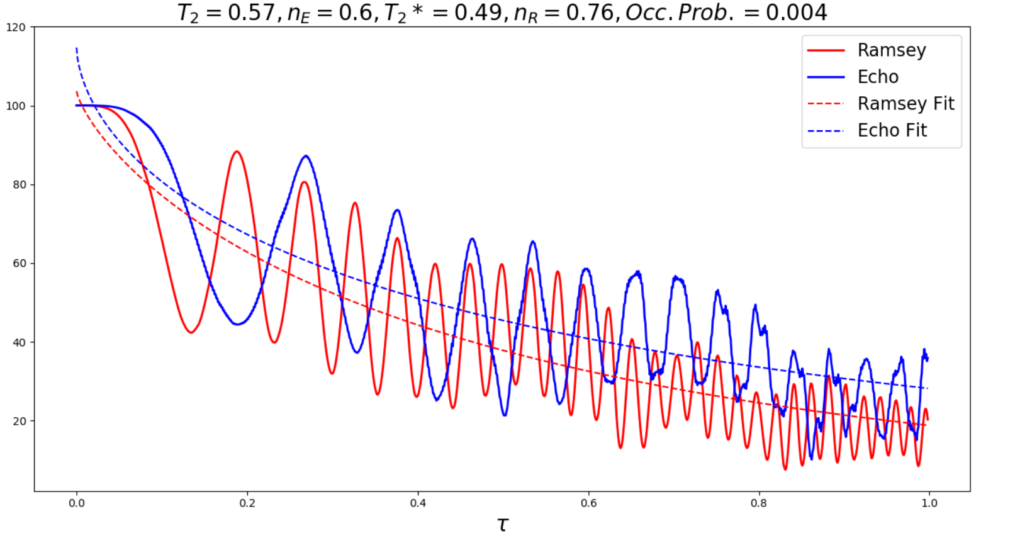
(python did not give the greatest fits at early times --- perhaps more averaging is necessary to smooth things out)

Slide 17
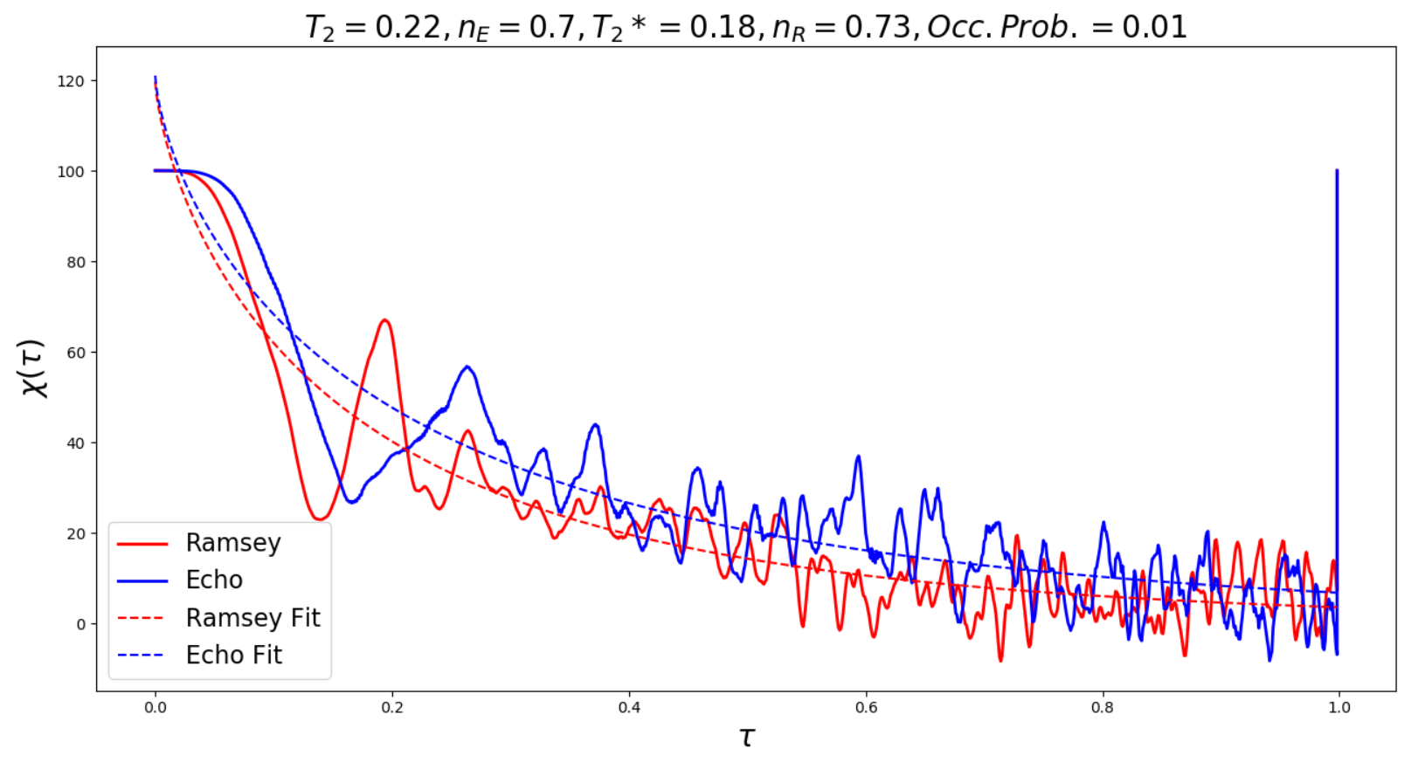
(python did not give the greatest fits at early times --- perhaps more averaging is necessary to smooth things out)

Slide 18
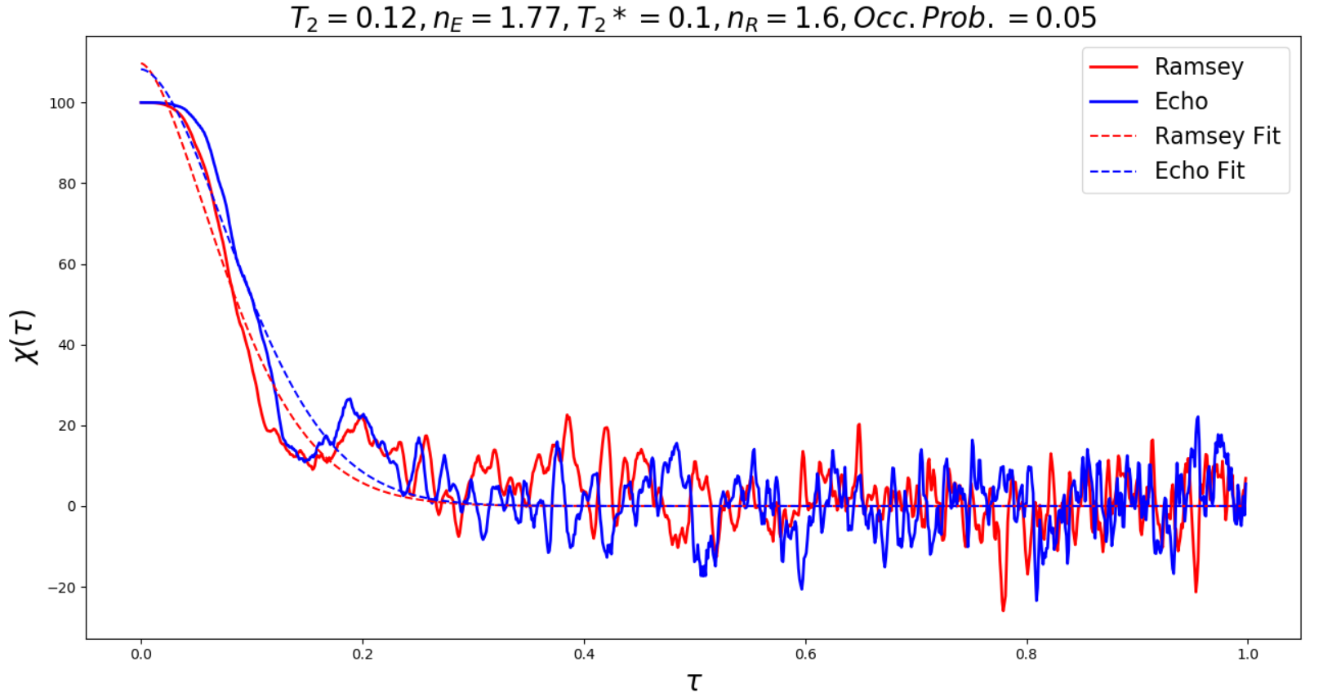
(python did not give the greatest fits at early times --- perhaps more averaging is necessary to smooth things out)

Slide 19
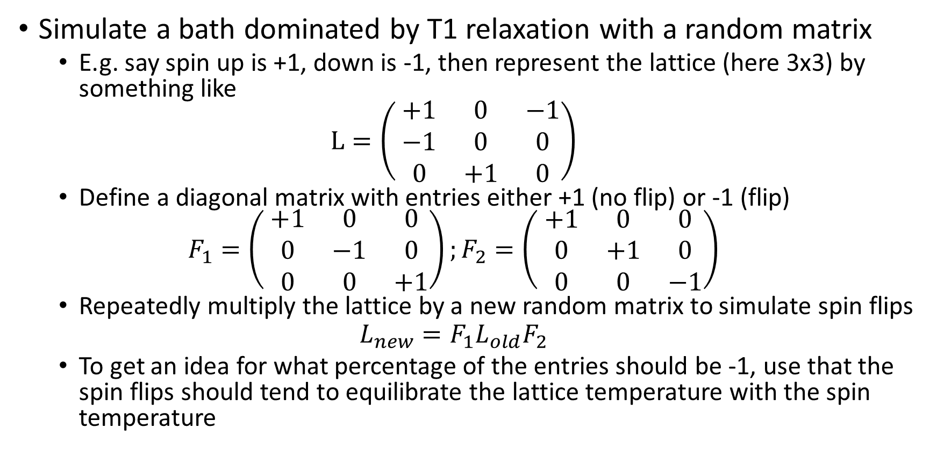
Other possibilities
Simulate a bath dominated by T1 relaxation with a random matrix
E.g. say spin up is +1, down is -1, then represent the lattice (here 3x3) by something like
$$L=\left( \begin{matrix}+1 & 0 & −1 \\ −1 & 0 & 0 \\ 0 & +1 & 0\end{matrix}\right)$$
Define a diagonal matrix with entries either +1 (no flip) or -1 (flip)
$$F_{1}=\left( \begin{matrix}+1 & 0 & 0 \\ 0 & −1 & 0 \\ 0 & 0 & +1\end{matrix}\right);F_{2}=\left( \begin{matrix}+1 & 0 & 0 \\ 0 & +1 & 0 \\ 0 & 0 & −1\end{matrix}\right)$$
Repeatedly multiply the lattice by a new random matrix to simulate spin flips
$$L_{new}=F_{1}L_{old}F_{2}$$
To get an idea for what percentage of the entries should be -1, use that the spin flips should tend to equilibrate the lattice temperature with the spin temperature

Slide 20
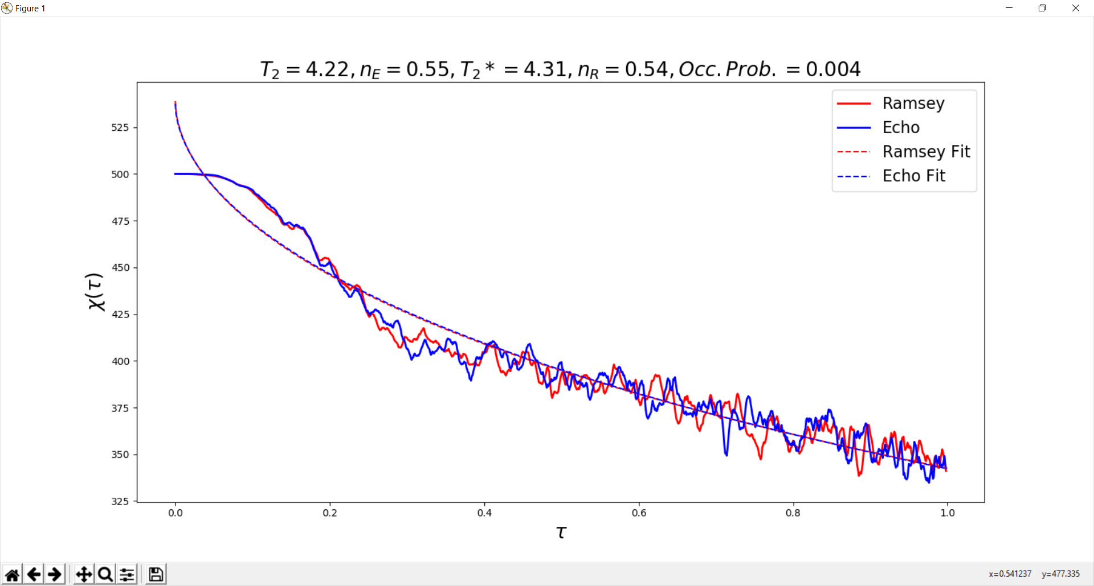
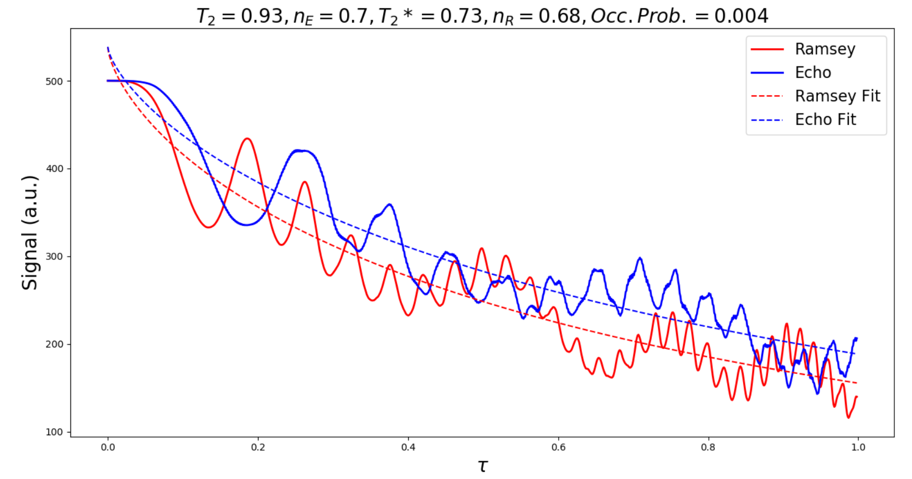
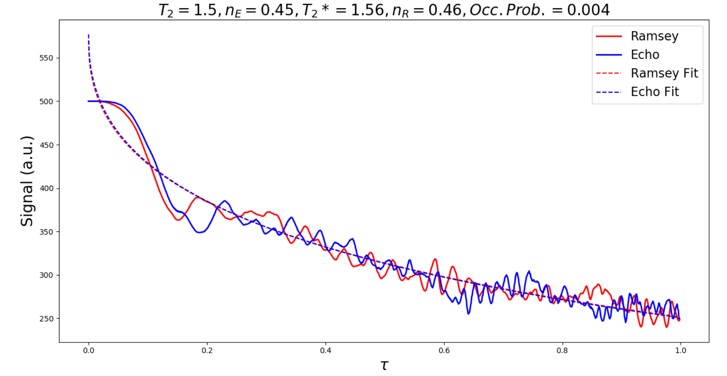
Spin-lattice type bath dynamics vs flip-flop type bath dynamics
Spin-lattice type relaxation;
~10% chance of being flipped at each time step
Flip-flop type relaxation;
Probability of flip-flop per unit time step =1/r³
Spin-lattice type relaxation;
~1% chance of being flipped at each time step
500 iterations each

Slide 21
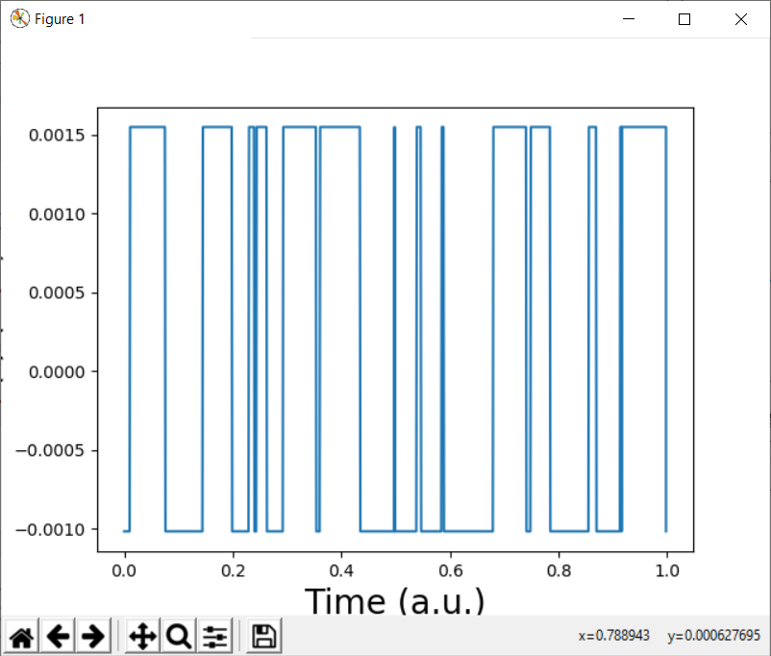
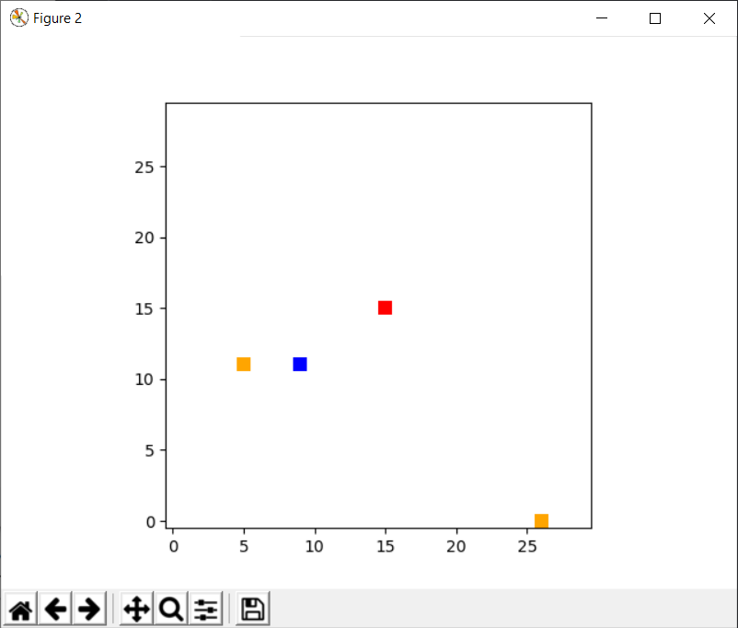
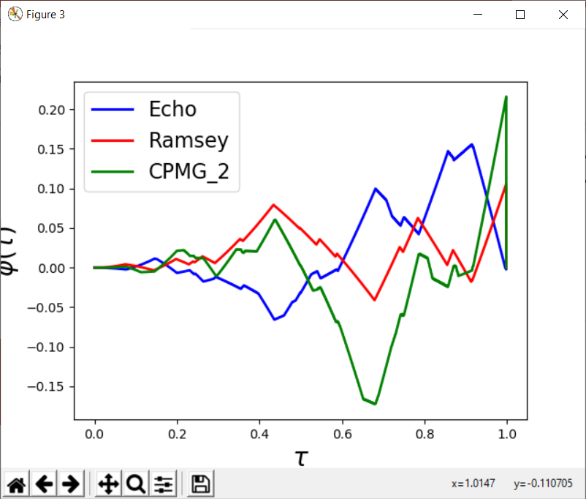
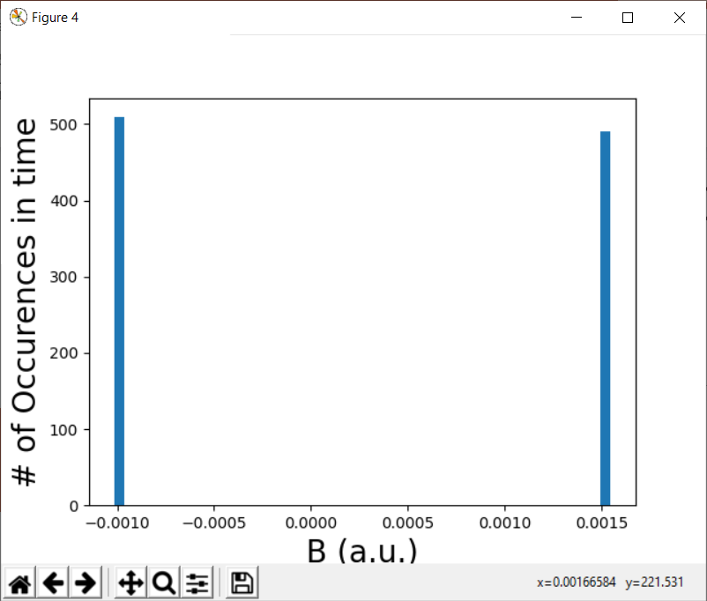
Occ. Prob. 0.01

Slide 22
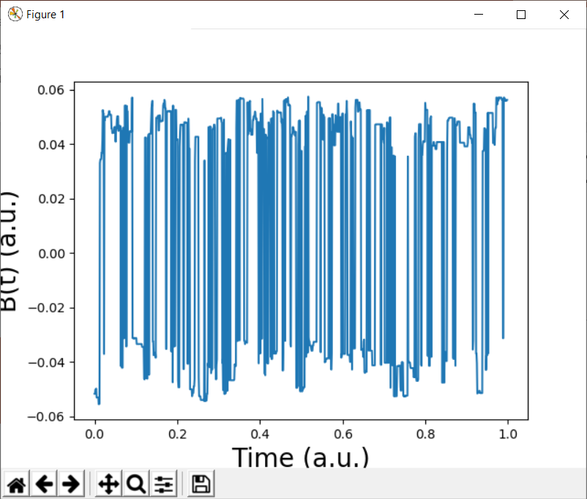
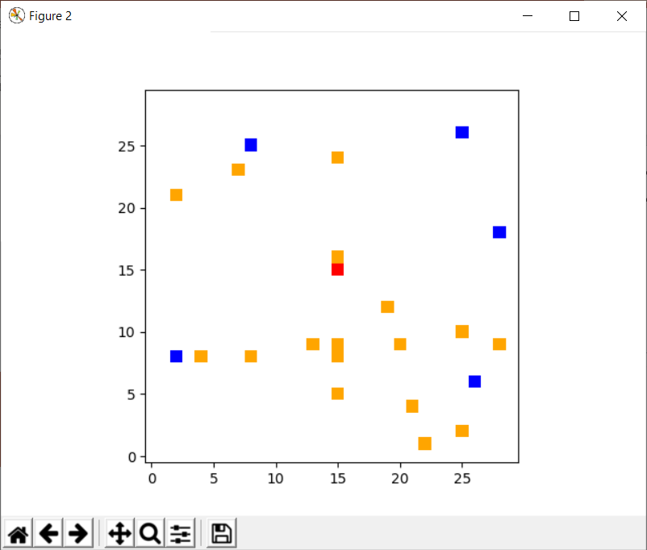
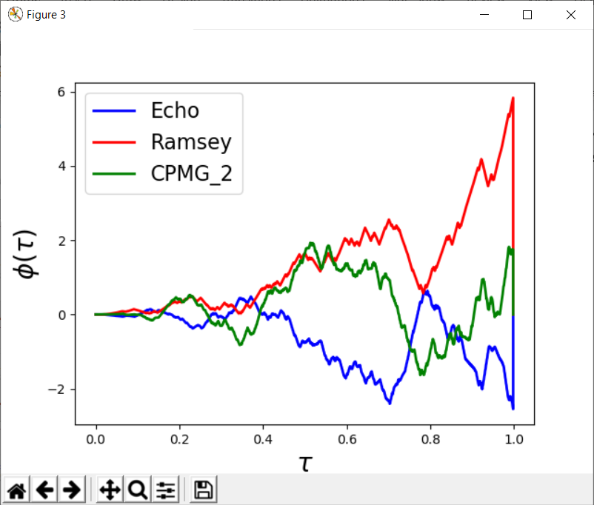
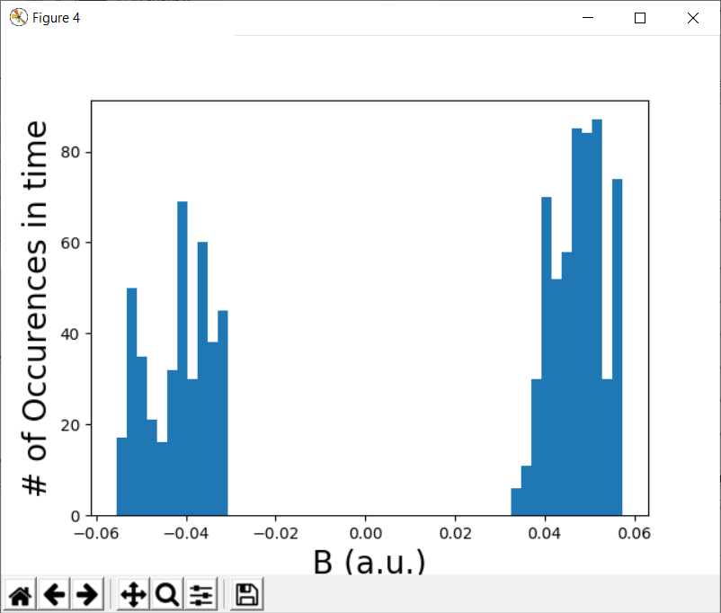
Occ. Prob. 0.02

Slide 23
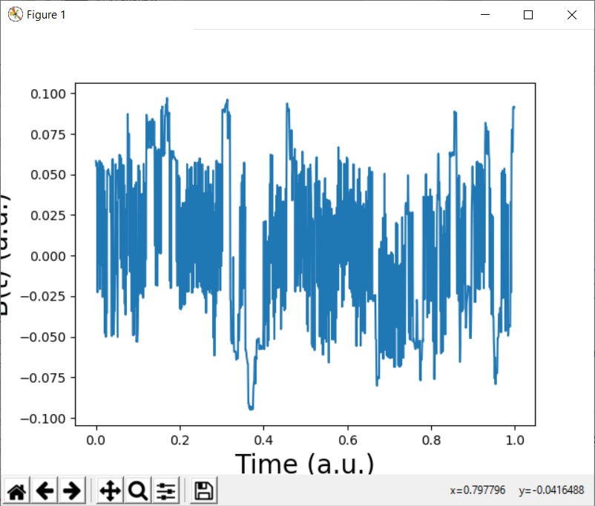
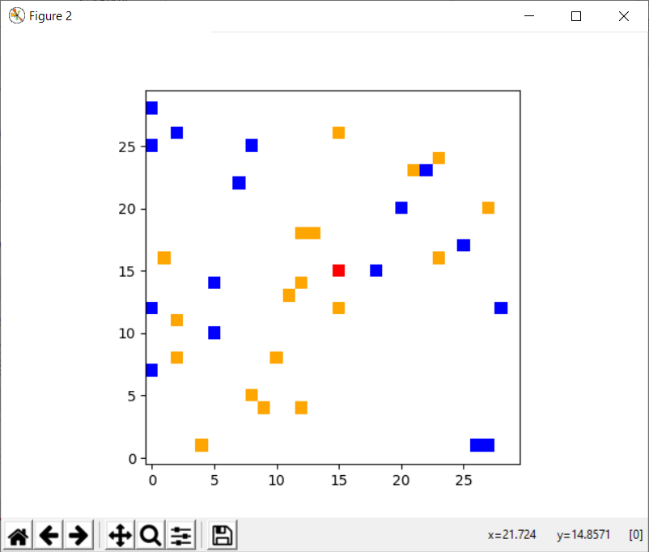
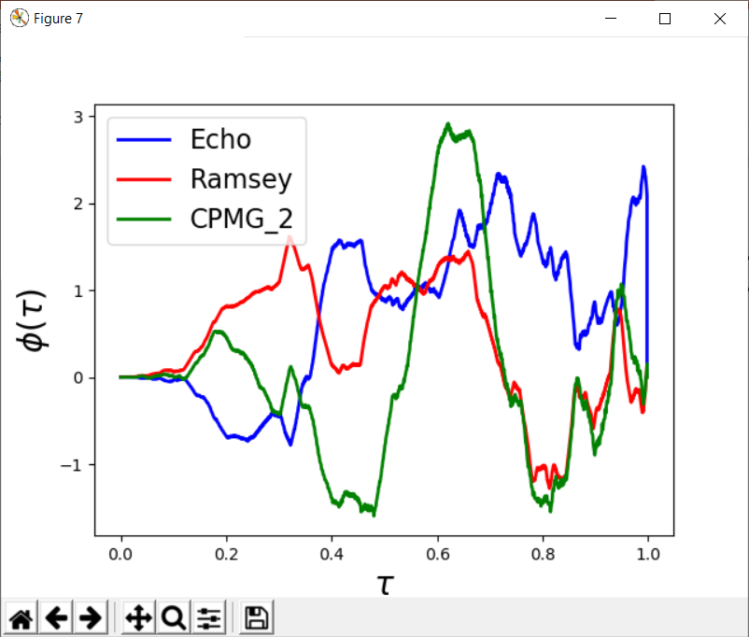
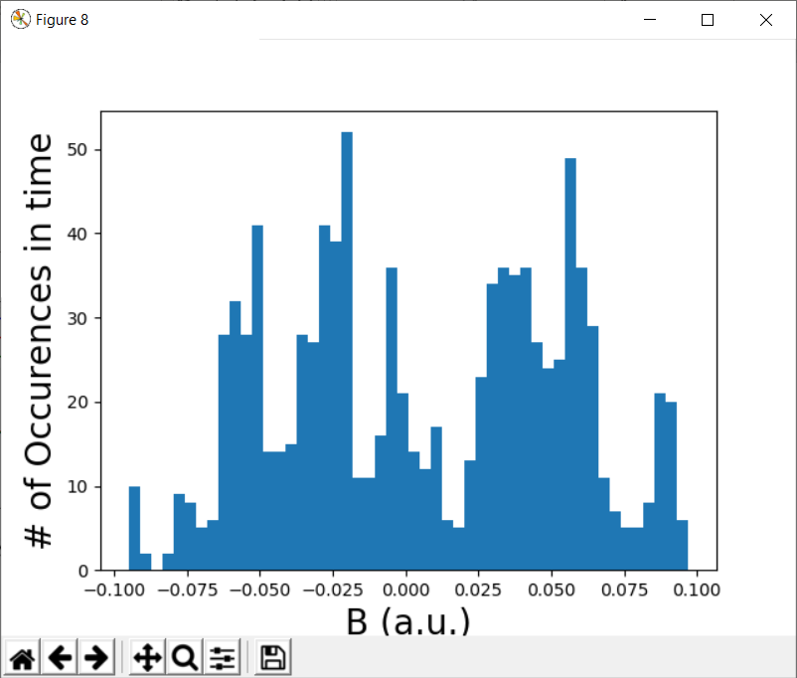
Occ. Prob. 0.05

Slide 24
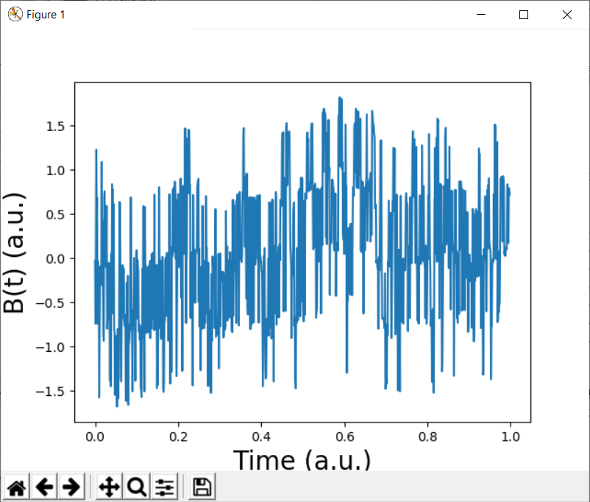
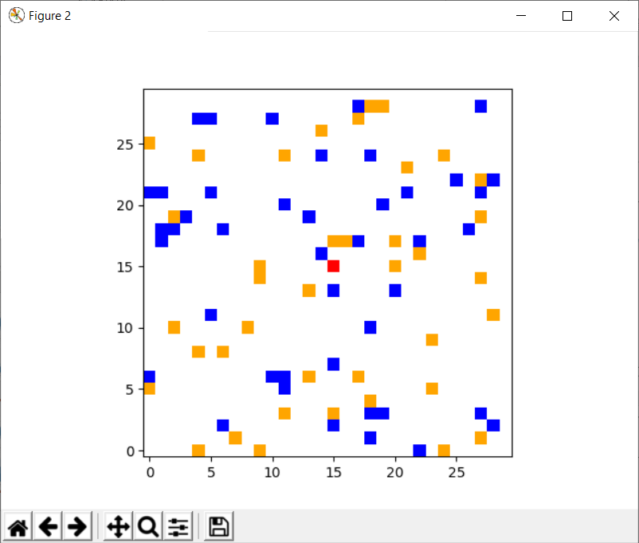
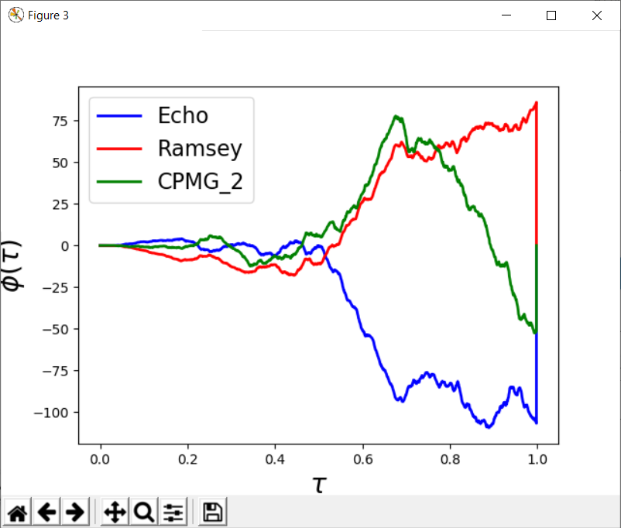
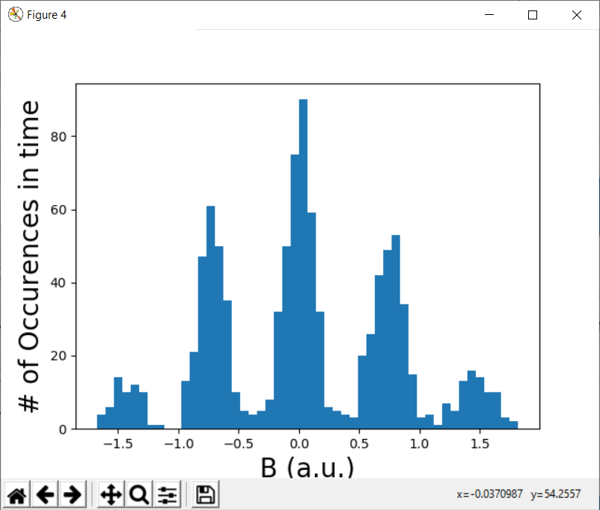
Occ. Prob. 0.1

Slide 25
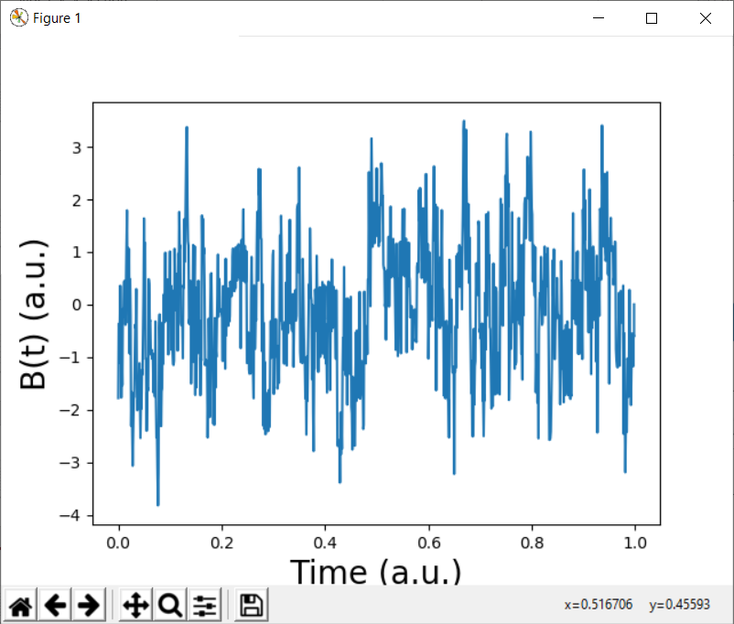
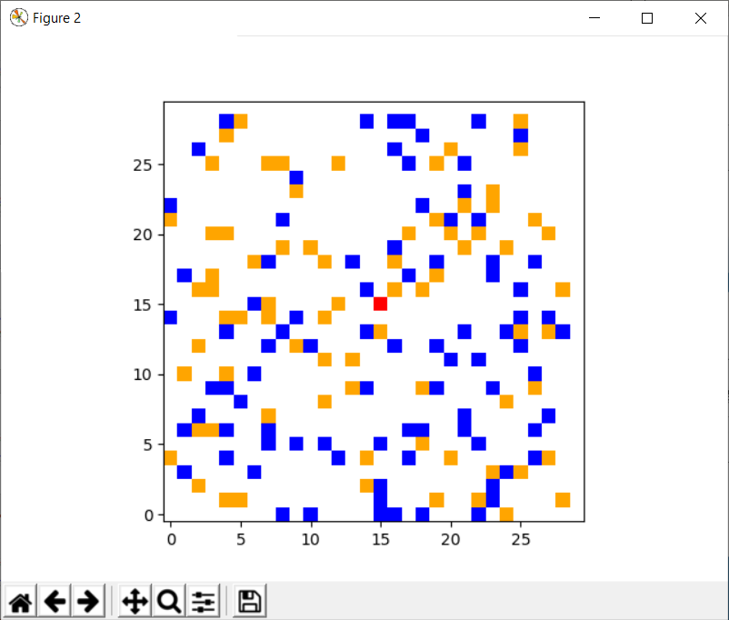
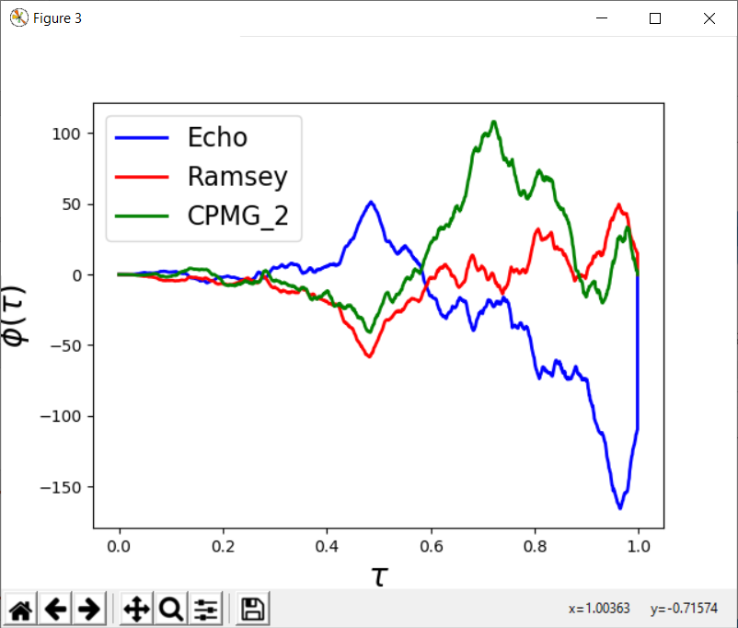
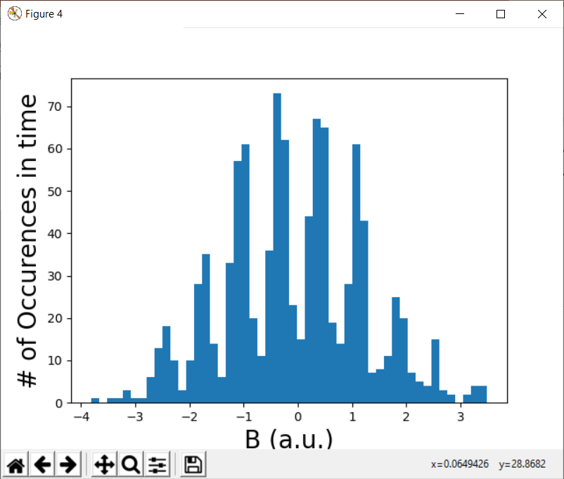
Occ. Prob. 0.2

Slide 26




Occ. Prob. 0.3

Slide 27
Old slides

Slide 28
Summary
Simulated spin bath dynamics to calculate Ramsey and Echo decays in 2 dimensions
Simulations are of the effective field at the NV
No unitary dynamics (b/c simulating a large bath); only simulating random occupations and random flip flops
Current simulations valid for either short times (easy to check) or gaussian noise (not true in the low-density cases). Working on more general simulations for arbitrary moments of the phase <φ^{n}>
Mounted L008 in 4209 – think we found TEM spots, but they are currently too far away from the waveguide to see a nice ESR.

Slide 29
Main ideas in the simulations
Randomly populate a 2D lattice with “bath” spins
Evolve the system in discrete time steps, inducing random flip-flops between bath spins at each time step (so total magnetization is conserved). No flip-flops with the central spin.
Calculate B at the central spin at each time step, giving B(t)
Calculate and fit the spectral density |S(ω)|² from B(t)
Calculate and fit the Ramsey and Echo decays from |S(ω)|² and their respective filter functions
Note: This should only work for a) small times (so that <cos(φ)> ~ <1- φ²/2> ~exp(-< φ²>/2)) or b) gaussian noise, in which case the last expression is exact
Working on a more complete code that uses the moments of φ to calculate the decay, without invoking the above assumptions
Takeaways/further questions:
Clear transition from sudden jump/telegraph noise to continuous/gaussian noise as a function of density
Calculate moments of φ around this regime (and hence the decay curve)

Slide 30






Occupation Probability = 0.005 sample dataset
NV
Spin up
Spin down

Slide 31






Occupation Probability = 0.02 sample dataset
NV
Spin up
Spin down

Slide 32






Occupation Probability = 0.035 sample dataset
NV
Spin up
Spin down

Slide 33






Occupation Probability = 0.05 sample dataset
NV
Spin up
Spin down

Slide 34





Occupation Probability = 0.1 sample dataset
NV
Spin up
Spin down

Slide 35






Occupation Probability = 0.2 sample dataset
NV
Spin up
Spin down

Slide 36



Results after 5 iterations at each occupation probability
Decay time
1/Decay time
Stretch parameter

Slide 37
Notes
Python did not seem to always give the best fit to the stretch parameter.
Log-log plots are included to easily see where it was underestimated
Fitting only early time tended to give better fits
Flip-flop probability per time step is given by F₀/r³ where F₀ is a constant (0 < F₀ < 1) and r is the distance between the two spins (r > 1)
r dependence is justified because the flip-flop terms come from dipolar couplings
All calculations are dimensionless. There are no factors of hbar, gamma, etc. in the code. Only looking that the functional forms of the spectral density and sequence decay, which shouldn’t depend on units.
Easily adjustable parameters include occupation probability, flip-flop probability, lattice size, spins in the bath (spin 1/2, 1, etc.) and tau_final

Slide 38

Fitting functions:
Spectral Density fit to two trial functions
Lorentzian $\left(∼\frac{1}{ω^{2}}\right): \frac{\frac{1}{2}Γ}{{\left(\frac{1}{2}Γ\right)}^{2}+{\left(ω−ω_{0}\right)}^{2}}$
$ω×$Lorentzian $\left(∼\frac{1}{ω}\right): \frac{\frac{1}{2}Γω}{{\left(\frac{1}{2}Γ\right)}^{2}+{\left(ω−ω_{0}\right)}^{2}}$
Echo and Ramsey fit to stretched exponential: $exp\left(−{\left(\frac{t}{T_{2}}\right)}^{n}\right)=exp\left(−\frac{χ\left(τ\right)}{2}\right)$
Again only strictly valid under a) short times or b) gaussian noise
$χ\left(τ\right)$calculated with the following filter functions:
$χ\left(τ\right)=∫{\left|S\left(ω\right)\right|}^{2}{\left|F\left(ω\right)\right|}^{2}dω$
Echo: ${\left|F\left(ω\right)\right|}^{2}$= $\frac{\sin^{4}\left(\frac{ωτ}{4}\right) }{ω^{2}}$
Ramsey: ${\left|F\left(ω\right)\right|}^{2}$= $\frac{\sin^{2}\left(\frac{ωτ}{2}\right) }{ω^{2}}$
Magnetic field at the central spin calculated as $\sum_{n=1}^{N}{\left(\frac{m_{s}}{{\left({\left(i −i_{0}\right)}^{2}+{\left(j −j_{0}\right)}^{2}\right)}^{\frac{3}{2}}}\right)}$ where m_{s} = +/-1 and N is the number of spins in the bath

